Slide 1
TAP EWA Week 1 Project
Differences in COVID 19 fatality rates among Countries
Derrick Muiru

Slide 2

Establish trends of deaths due to COVID -19 of different regions and countries..
AGENDA
Design a solution that shows how different variables affect COVID related fatalities between different countries.
Test a hypothesis to how different Regions are dealing with COVID-19.

Slide 3
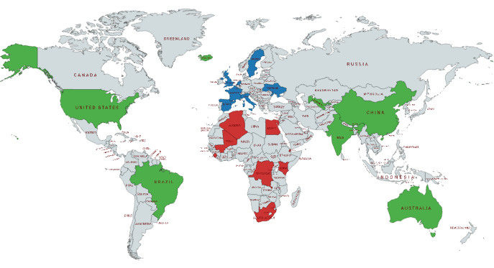
ASSUMPTIONS
SAMPLE
COUNTRIES
KEY
1.The COVID-19 data collected is correct.
2.The first day of data recorded for each country was the first case.
3. When dealing with one variable that affects death, all factors are held constant.
These countries have been chosen randomly with a check on data authenticity.
These are six regions that have been chosen for the research.
21
countries
Africa
Europe
Rest of the world
AS AT 1st SEPTEMBER
25,509,135
Total Confirmed
24.5%
850,902
Total Deaths
9168
Population per deaths
HYPOTHESIS
Null Hypothesis :
Different regions of respond to COVID -19 the same way.
TOOLS USED
Edit text here
Orange – Data mining

Slide 4

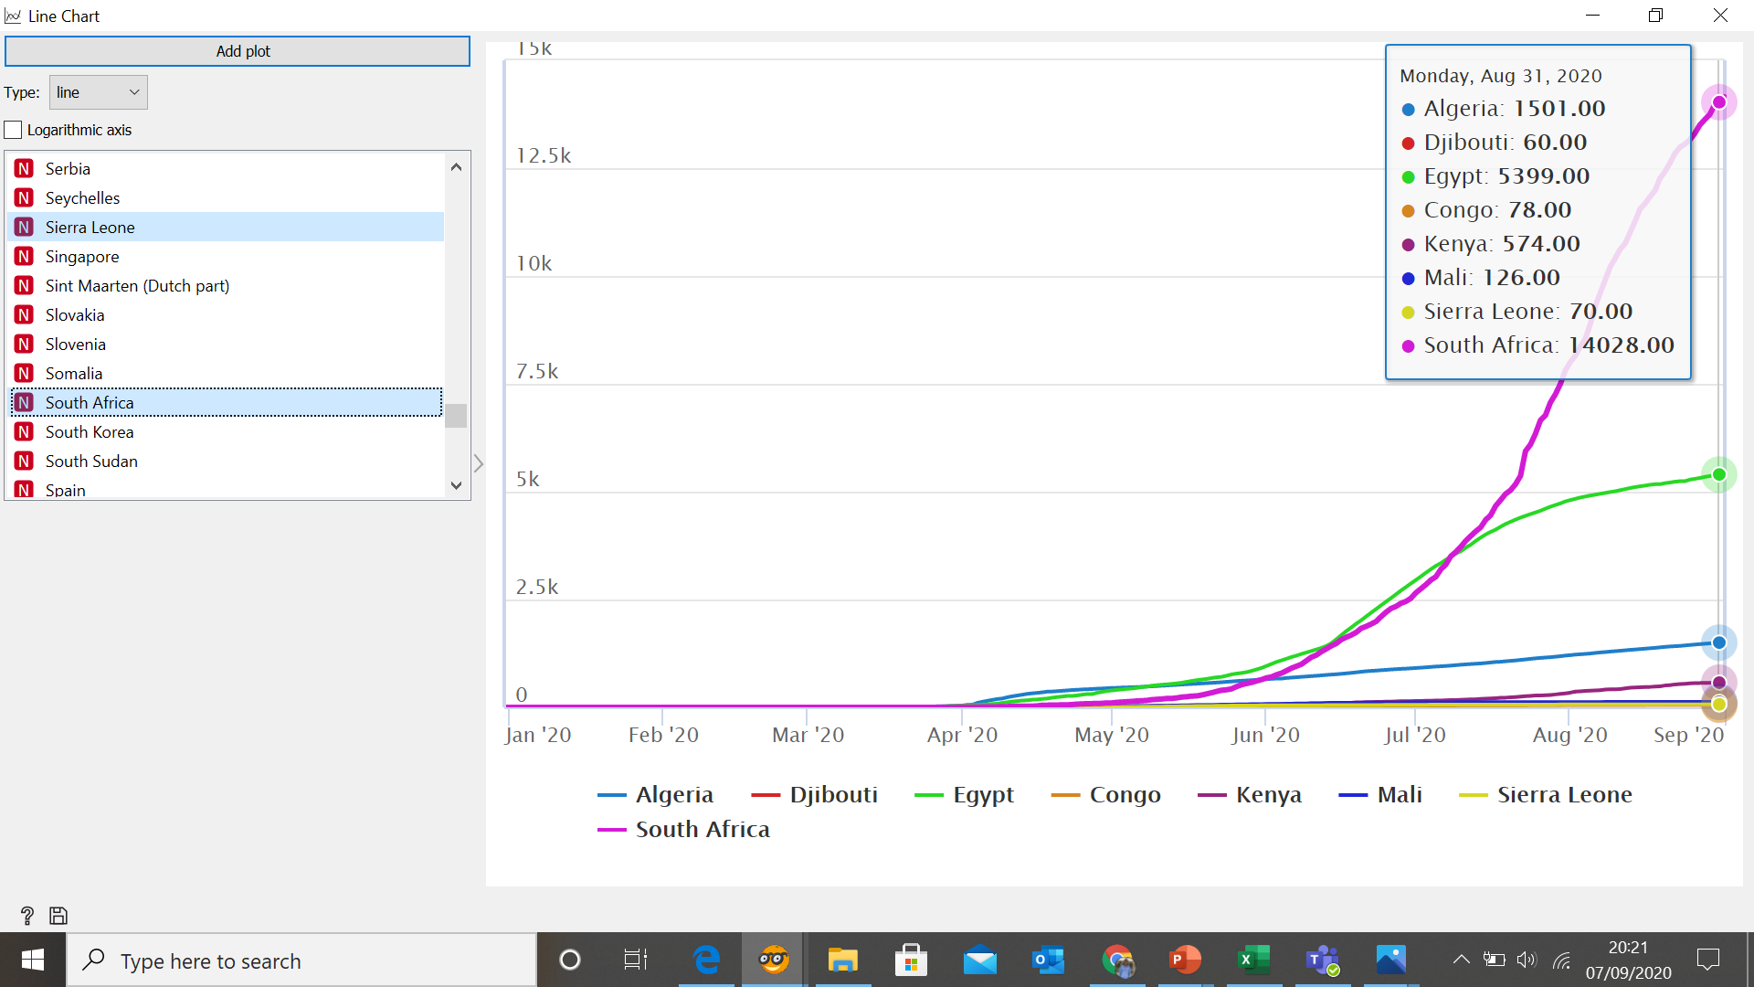
AFRICA
There are 54 countries in Africa, but we sampled 8 countries only.
Deaths per country
POPULATION PER DEATHS
A lower value of Populations per death shows criticality and a high spread of the virus across the country’s population.
South Africa – 4228.
Egypt - 18954.
Algeria - 29214
Congo – 70744.
Kenya – 93678.
Sierra Leone – 16466
Djibouti – 113957
Mali – 165898.

Slide 5

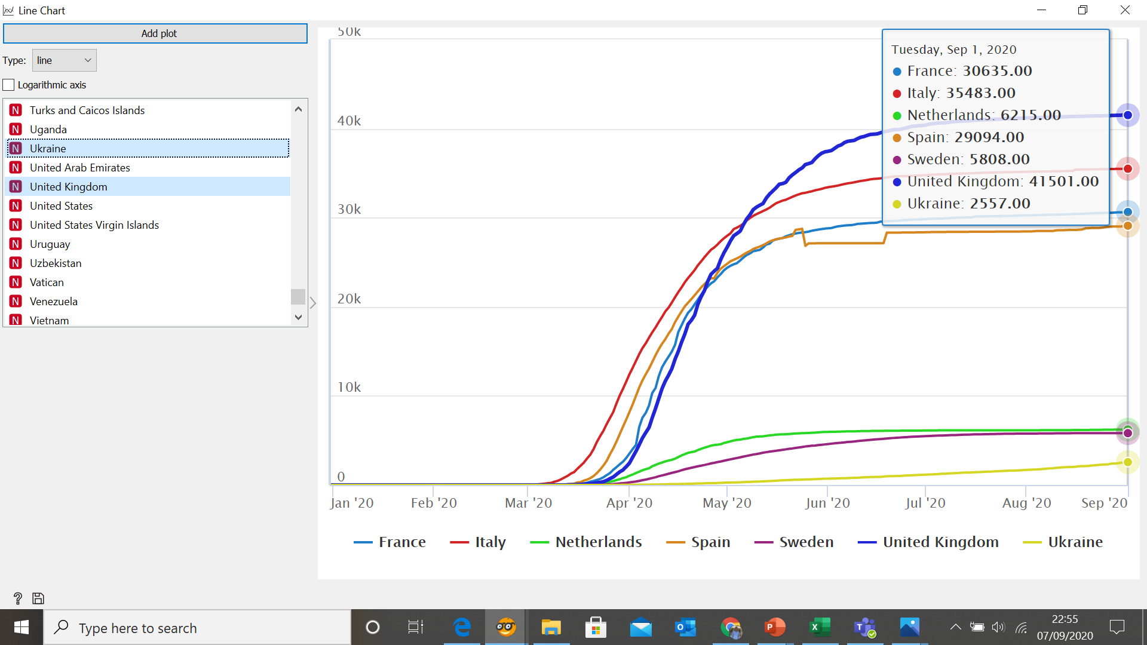
EUROPE
There are 44 countries in Europe, but we sampled 7 countries only.
Deaths per country
POPULATION PER DEATHS
Spain– 4228.
United Kingdom- 18954.
Italy - 29214
Sweden – 70744.
France – 93678.
Netherlands – 16466
Ukraine– 113957
European countries have dealt with the spread of the Corona Virus in an effective way to curb the spread. From June the sampled countries have had a reduced number of deaths.

Slide 6
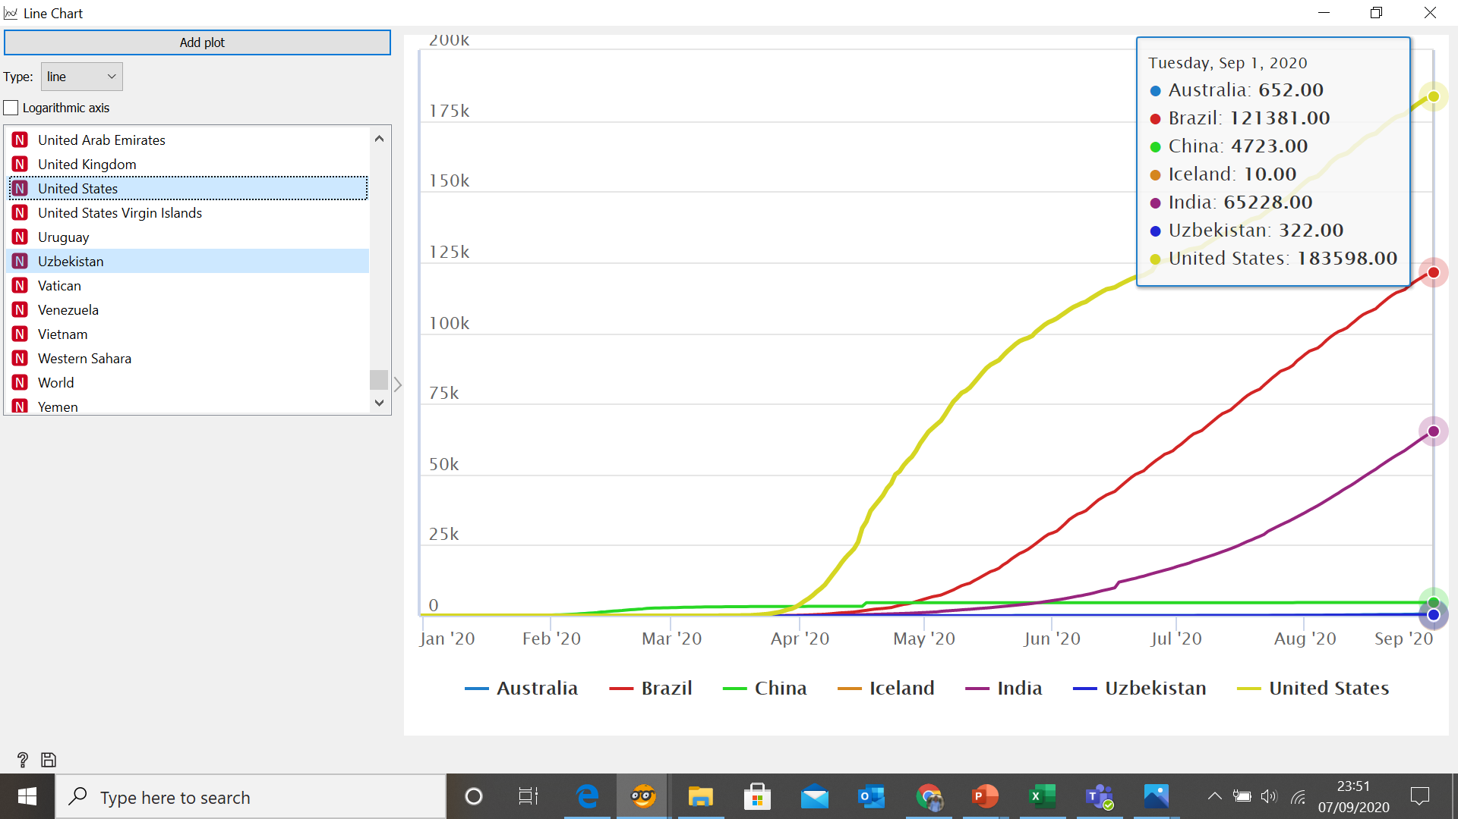
REST OF THE WORLD
.The rest of the world is represented by the continents Australia, North and South America as well as Asia
Deaths per country
POPULATION PER DEATHS
Brazil – 1753.47
United States – 1802.87
India – 21232
Iceland – 36413
Uzbekistan – 104214
China – 301772
Australia -39191

Slide 7
CONCLUSION
1. Different regions and countries in the world have different responds to COVID-19.
2. Europe has been able to curb the number of fatalities better than other regions.
3. Everyone is advised to continue washing hands and sanitizing, wearing a mask and maintaining a social distance while in public places.
4. Will investigate other different variable effects to the COVID-19 statistics.

Slide 8
Thank you
Questions

